Slide 1
SADEEQ Mobile/Web App

Slide 2
Product Overview
Sadeeq is a cross-platform hybrid (mobile &web) application aiming to bridge the gap between service seeking DEMAND and service providing SUPPLY.
Sadeeq empowers service industry businesses to get along with advance technology & Digital transformation by connecting service seekers with service providers.
Sadeeq helps businesses grow and nurture a consumer-first mindset.

Slide 3
Business Portfolio – B2C
Our customer in B2C portfolio is the end user of the application.
We will develop a web app and mobile app for the end user.
Using the application, the end user will be able to:
Register
login
select location
create profile
browse services
select services/microservices
select quantity and price
add services to cart
checkout
select payment options
book services
track services
receive services
provide reviews and ratings
buy membership/subscription
refer and earn.

Slide 4
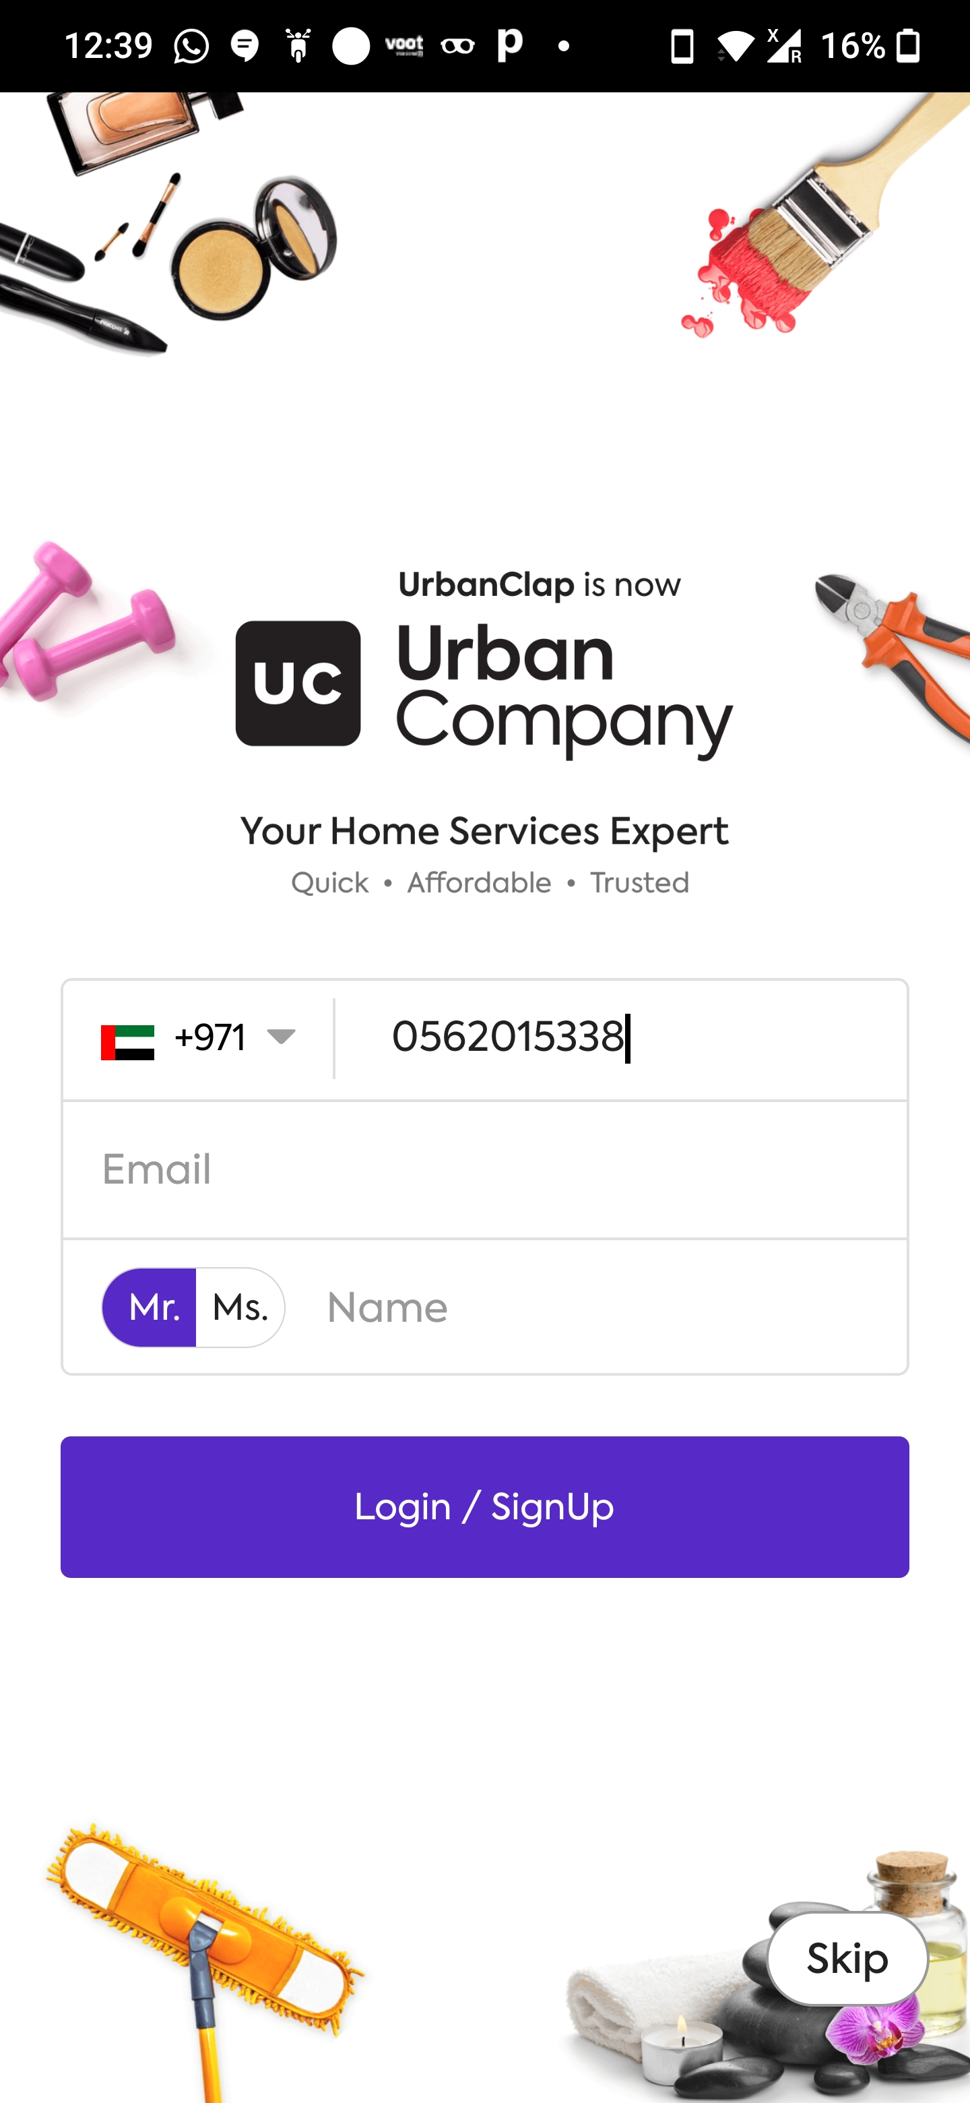
Register
If the user is new, they have to register themselves.
At the time of registration, the user needs to provide: *Name, *Phone number, *Email ID, Payment details.
After the user feeds these details, we need to verify the phone number via OTP.

Slide 5
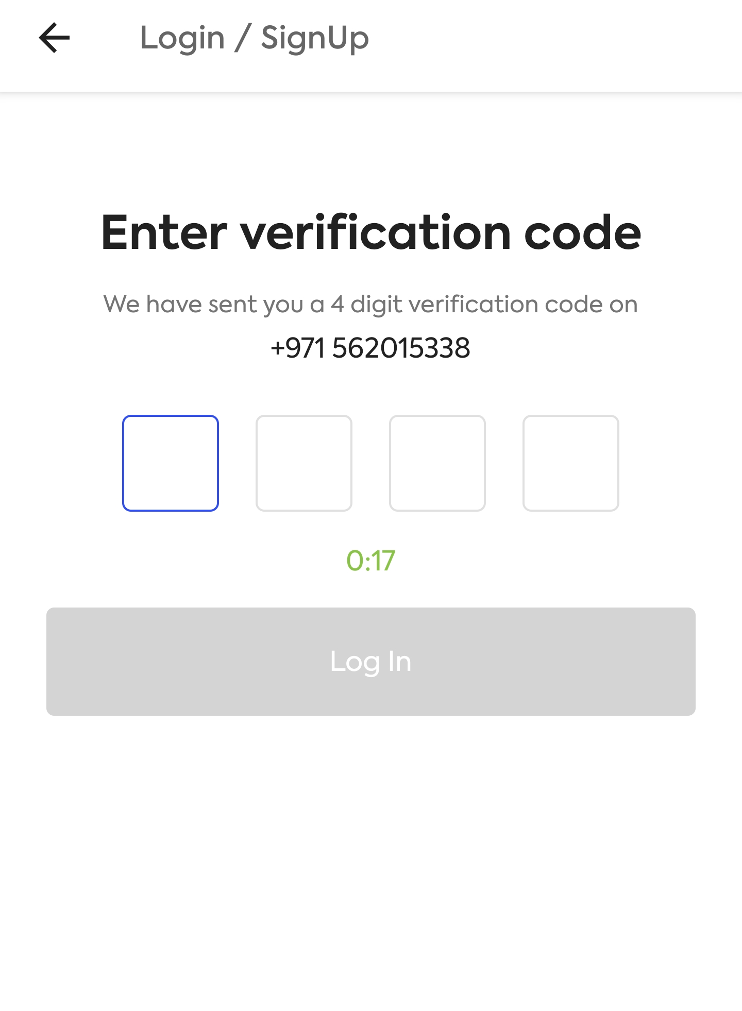
OTP Verification
The user will receive a 4 digit OTP on the given phone number at the time of registration.
The OTP will have 2 minutes timer, after which it expires and the user will have to request to resend OTP.
The OTP must have Auto-fill option.
Once the OTP is verified, the user will be successfully registered.

Slide 6
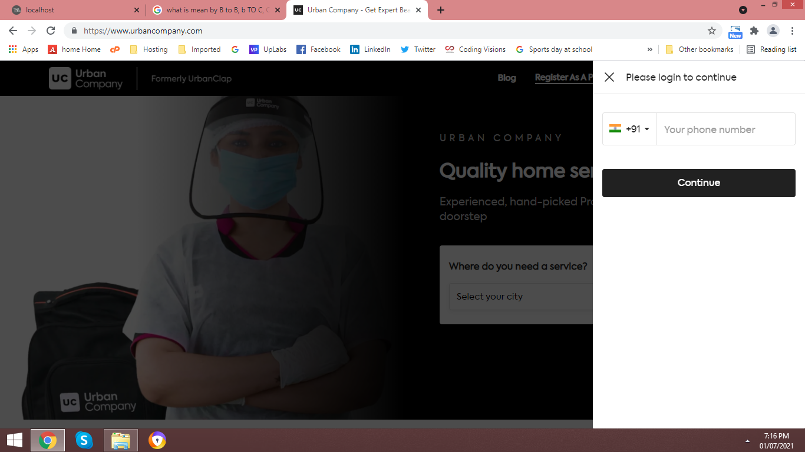
Login
After successful registration, the user will be logged into the app.
If they have logged out, they need to login again to enter the app.
Login Page will require only their phone number and OTP.
Social Media login options should also be available.

Slide 7
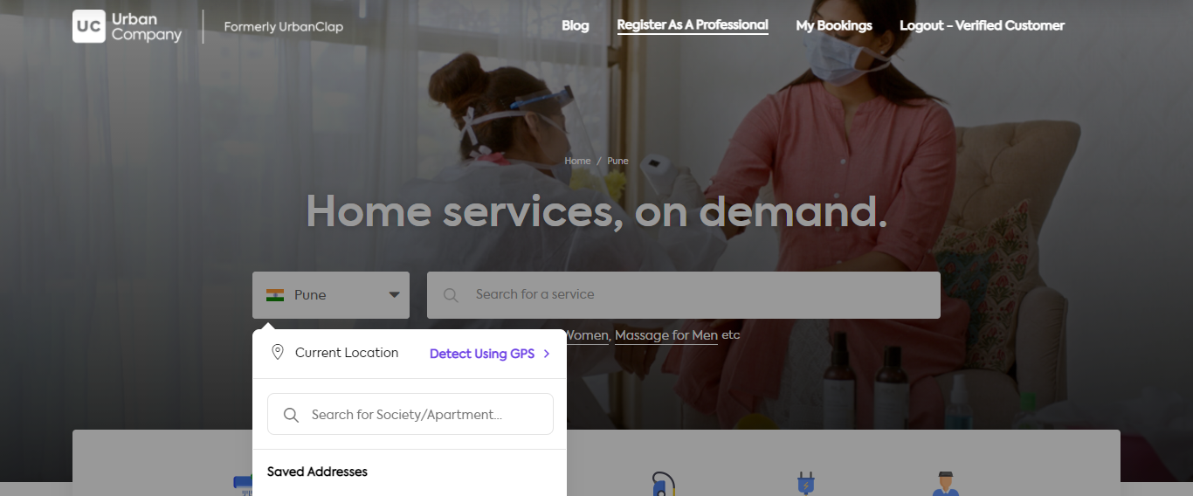
Select Location
After the user logs into to app, A map is prompted at them.
The user will have to search and enter the location where the service is required.
Once the location is entered, geo fencing will be applied and service providers who work in those location will be visible to the users.

Slide 8
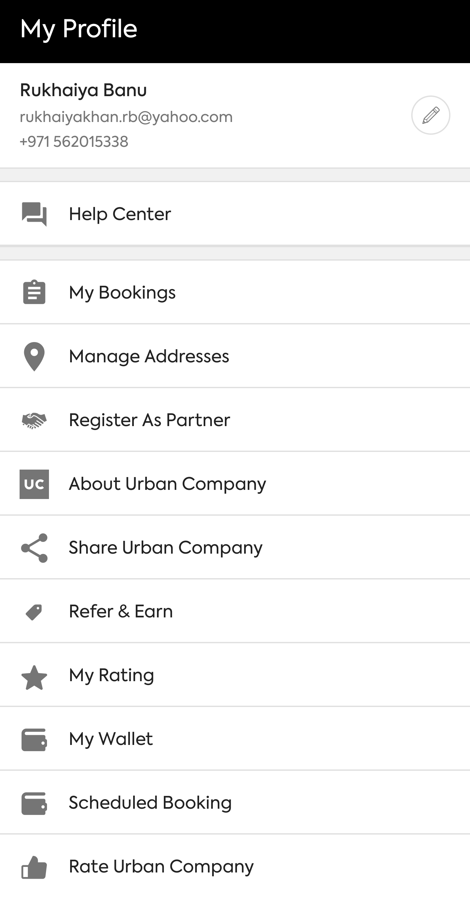
Create Profile
After successful login, the user will be prompted to create their profile.
This is an optional step, it can be skipped and the user can move forward irrespective of it.
Profile creation: Display picture, manage addresses, ratings, wallet, payment options, settings, etc.
OTP rules are same as that of Registration process.

Slide 9
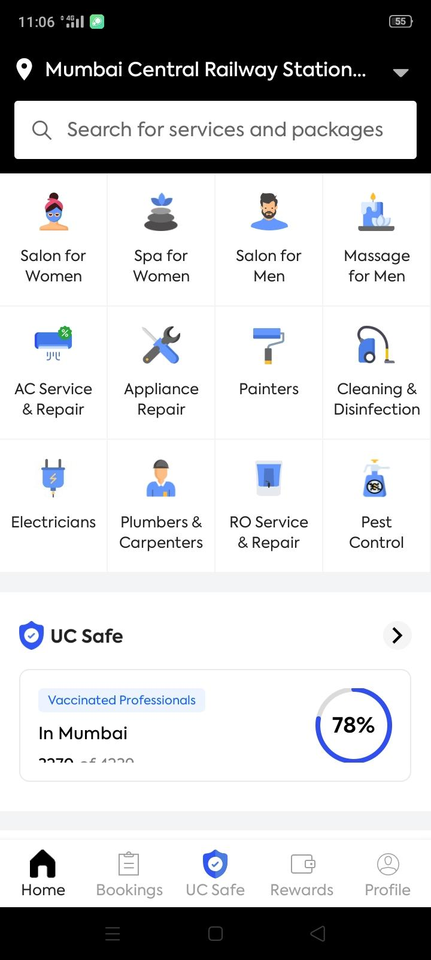
Services Dashboard
After successful login, the landing page will be services dashboard.
The services dashboard will list all the services we provide.
Services will be divided into categories, sub categories, sub sub categories, etc.
The services dashboard must be interactive.

Slide 10
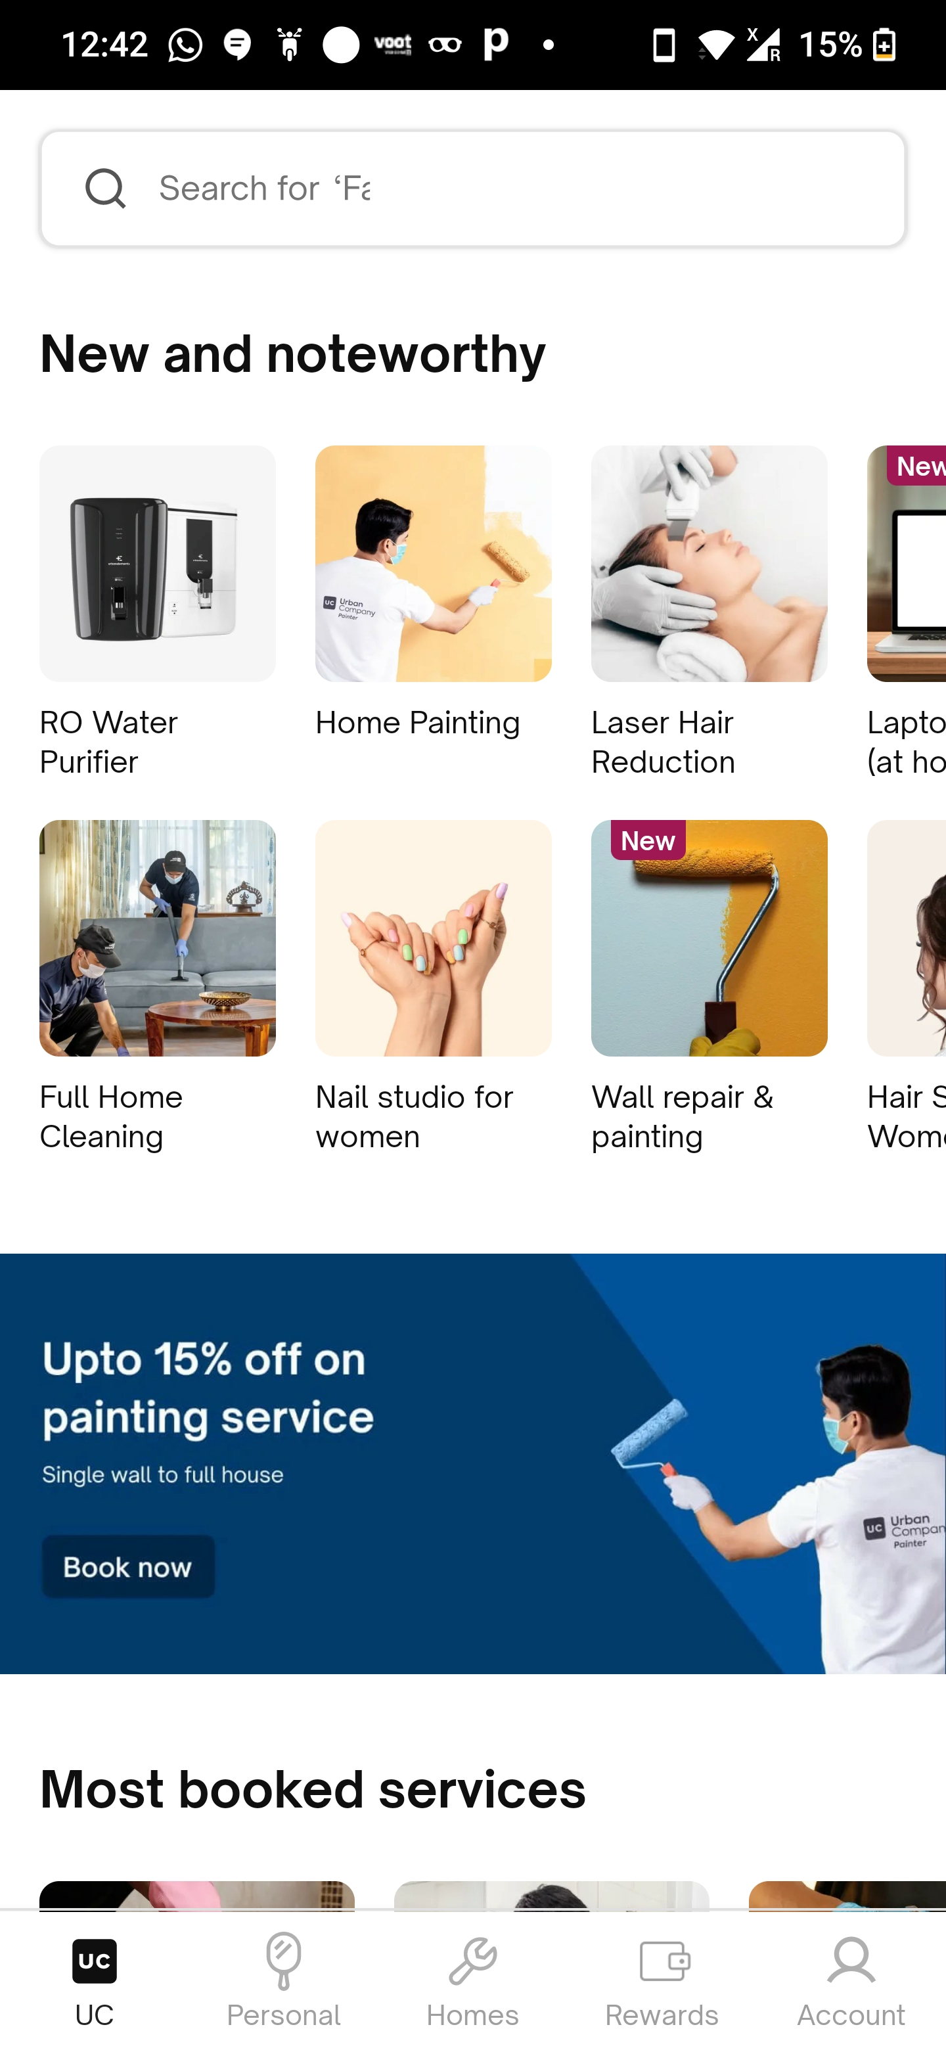
Select Services
After navigating through the services dashboard, the user will have to select the service they require.
Once they select the service category, sub categories will appear and the have to select the exact problem that needs to be fixed.
The user can select multiple services.

Slide 11
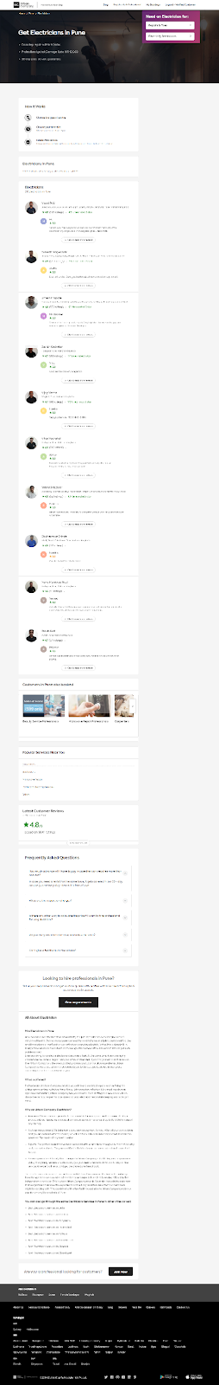
Choose service provider
After the user has selected a service, there will be two options for them to select the service provider:
One, they can pick the service provider themselves from the list of providers that we display to them (geo fencing). This list will have filters such as price(h/l), ratings, skills, experience, availability, etc.
Two, the user can opt for the app to automatically select the service provider (geo fencing).

Slide 12
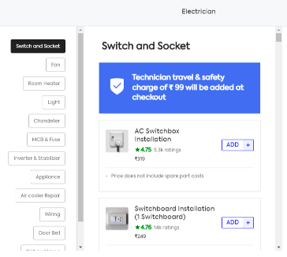
Select Quantity & Price/Hours
After selecting the service, the user must select the quantity of services required.
According to the selected quantity, the prices will vary.
For services that are charged hourly, the user should select the total number of hours required for the service to be completed.

Slide 13
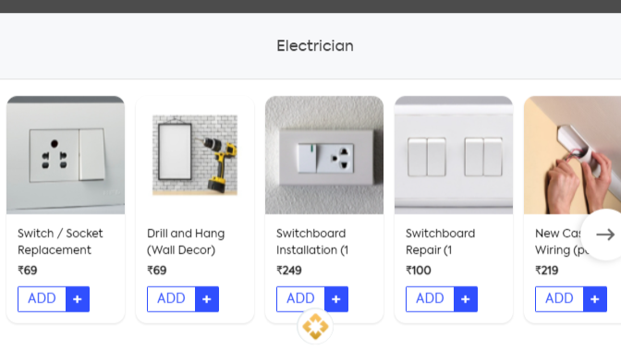
Add to Cart
After selecting the service and the quantity of services required, the user will have to add these to the cart.
Multiple services can also be added to the cart.
The services and its quantities can be added/deleted from the cart.
Cart – CRUD.

Slide 14
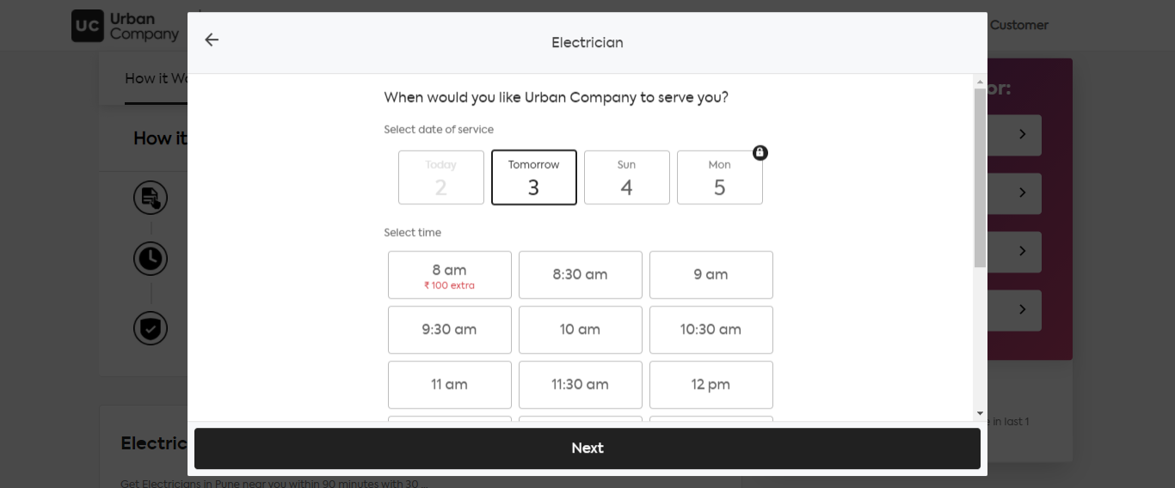
Select Date and Time
After selecting the service and the quantity of services required, the user will have select the date and time for the service booking
The dates and time can be rescheduled.

Slide 15
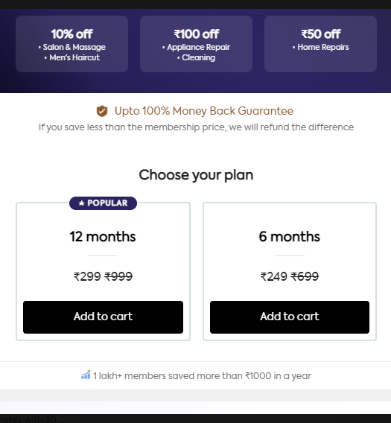
Select Membership
Before the checkout, the user will be prompted to purchase memberships/subscriptions.
This is optional, the user can skip it and move forward.
These subscriptions will unlock special features and discounts for the user.

Slide 16
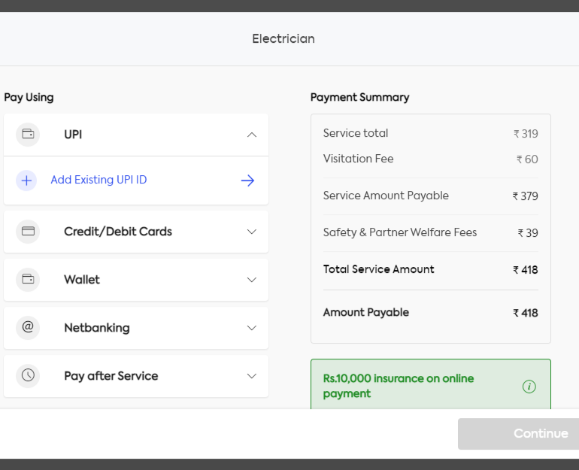
Checkout
Once the cart is loaded with services required, the user needs to proceed to checkout.
Here, the user must select payment option.
Upon selection of the payment method, the user must enter card details/other payment details (which will be stored for further use)
Without entering the payment details, the booking cannot be made.
The user can choose to pay upfront or after the service delivery, but the payment details should be given before booking.

Slide 17
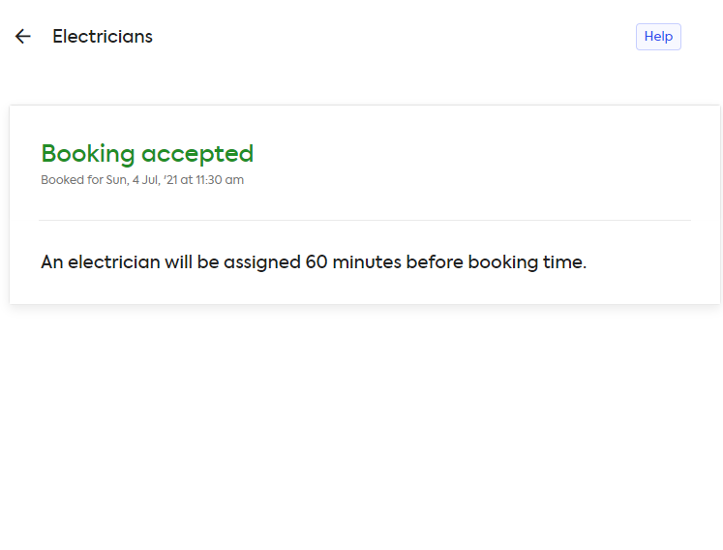
Book the Service
After the payment details have been entered, or the payment has been made, the user will book
Here, the user must select payment option.
Upon selection of the payment method, the user must enter card details/other payment details (which will be stored for further use)
Without entering the payment details, the booking cannot be made.
The user can choose to pay upfront or after the service delivery, but the payment details should be given before booking.

Slide 18
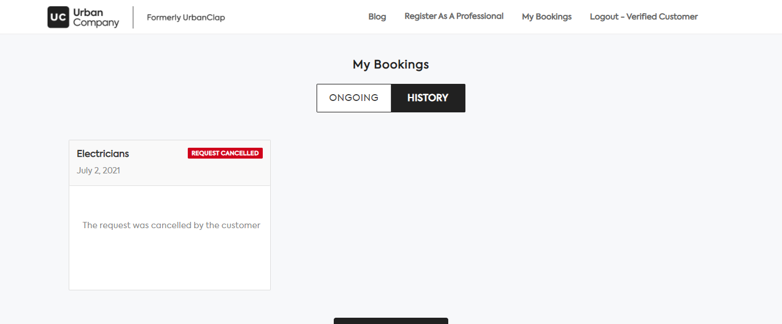
Track Services
The user should be able to track services.
Any update in the booking status should be alerted to the user.
Here, the user can have reschedule and cancellation options.

Slide 19
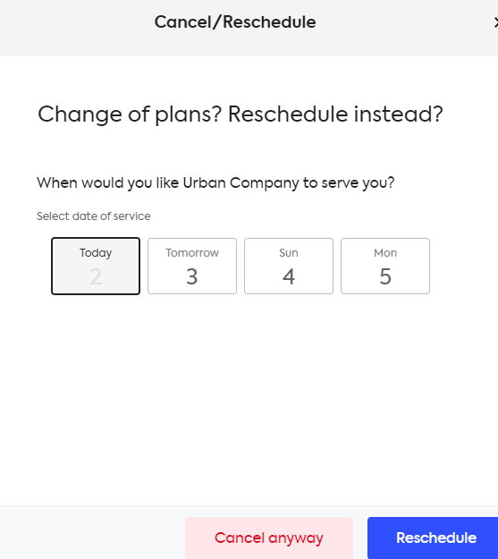
Reschedule Services
The user will be able to reschedule the booking prior to a given time period.
No extra charges are applied for rescheduling.
Reschedule option per service can be used only a few times.

Slide 20
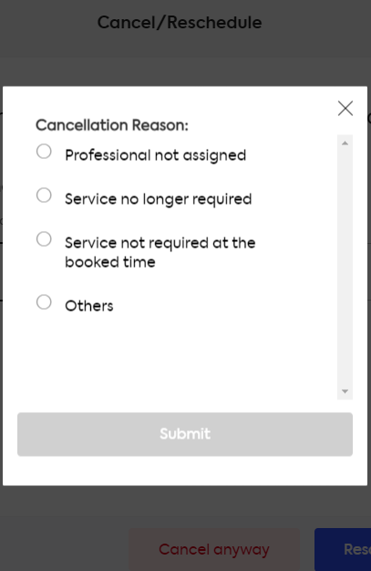
Cancel Services
The user will be able to cancel the booking prior to a given time period, by mentioning the reason for cancellation.
No extra charges are applied for cancelling if done prior/ within the given time till execution.
If done after the time has been elapsed, booking fee will be automatically deducted.

Slide 21
B2B Portfolio : Service Providers (SP)
We will deal with the service providers in our B2B portfolio.
We will develop a web app and mobile app for the SPs.
Using the application, the end user will be able to:
register
login
create profile
services/microservices
add quantity and price
accept bookings
reject bookings
start service
end service
get payments
provide reviews and ratings
buy membership/subscription
refer and earn

Slide 22
Register
If the SP is new, they have to register themselves.
At the time of registration, the SP needs to provide: *Name, *Phone number, *Email ID, TL etc.
After the SP feeds these details, we need to verify the phone number or Email via OTP.

Slide 23
OTP Verification
The SP will receive a 4 digit OTP on the given phone number at the time of registration.
The OTP will have 2 minute timer, after which it expires and the user will have to request to resend OTP.
The OTP must have Auto-fill option.
Once the OTP is verified, the user will be successfully registered(temp).

Slide 24
Login
After successful registration, the SP will be logged into the app.
If they have logged out, they need to login again to enter the app.
Login Page will require only their phone number and OTP.
OTP rules are same as that of Registration process.

Slide 25
Create Profile
After successful login, the SP will be prompted to create their profile.
This is an mandatory step, it cannot be skipped.

Slide 26
Profile Creation: Individual
For Individual SP, the profile creation form will have fields such as:
Name
Number
Email ID
Passport
emirates ID
license (if any)
Address
bank details
vaccination details, etc.
After the form is submitted, it will be sent for a review.
An individual will only have access to 3 types of Services at the time of registration (FOC). Any additional services that he can render needs to be charged separately (For e.g. AED 20 per month per Service)

Slide 27
Profile Creation: Organization
For Organization SP, the profile creation form will have fields such as:
Company name
Number
email id
address
license
VAT registration certificate
bank details
partner (in any)
number of employees and their details
vaccination details of all employees, etc.
A company will only have access to 3 types of Categories of Service at the time of registration (FOC). Any additional category that they can render needs to be charged separately (For e.g. AED 200 per month per Category)
After the form is submitted, it will be sent for a review.

Slide 28
Profile Review
After the profile creation forms have been submitted, they will undergo a strict review and then it will be verified.
If the profile is verified, the SP is successfully registered and created.
If not, the process repeats.

Slide 29
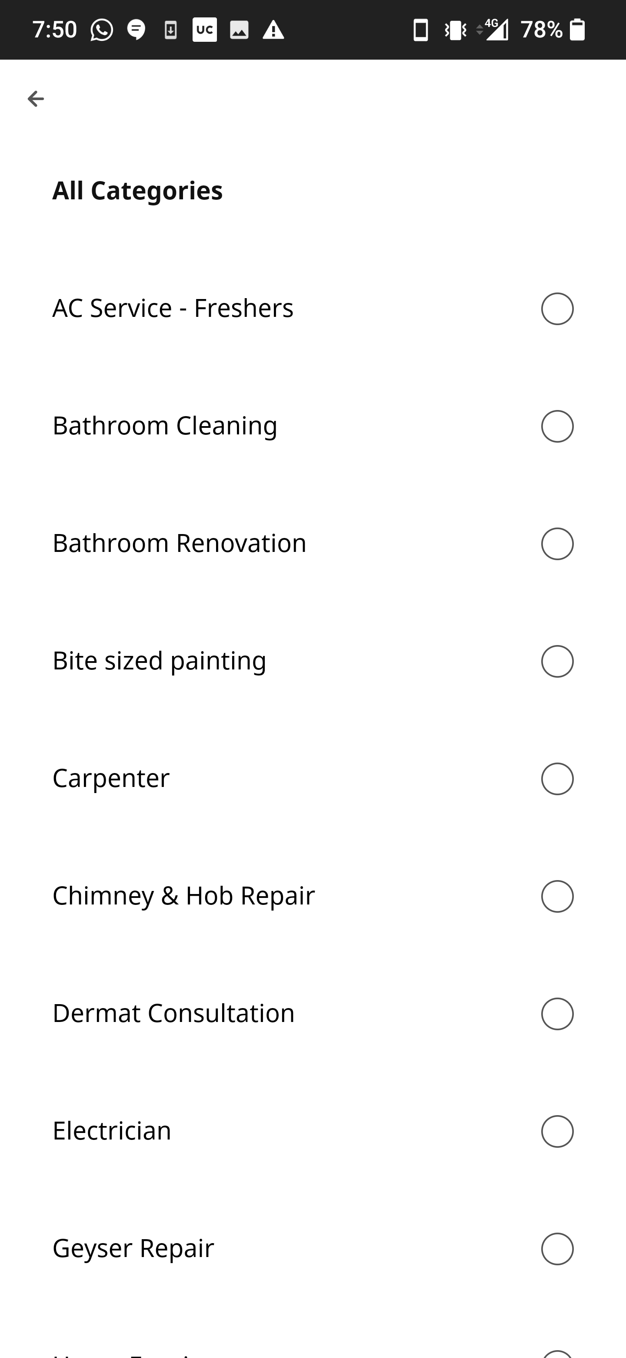
Add Services
The SP must select the list of services/subservices they wish to provide.
These services will be selected from the service catalogue we provide.
The number of services a SP can select depends on the package they have chosen.

Slide 30
Add Prices
For the services selected, the SP must add its respective prices
For standard services, a fixed price must be mentioned.
For consultation services, hourly charges must be mentioned.
Extra charges if the service time is exceeded from the booking session must also be mentioned.

Slide 31
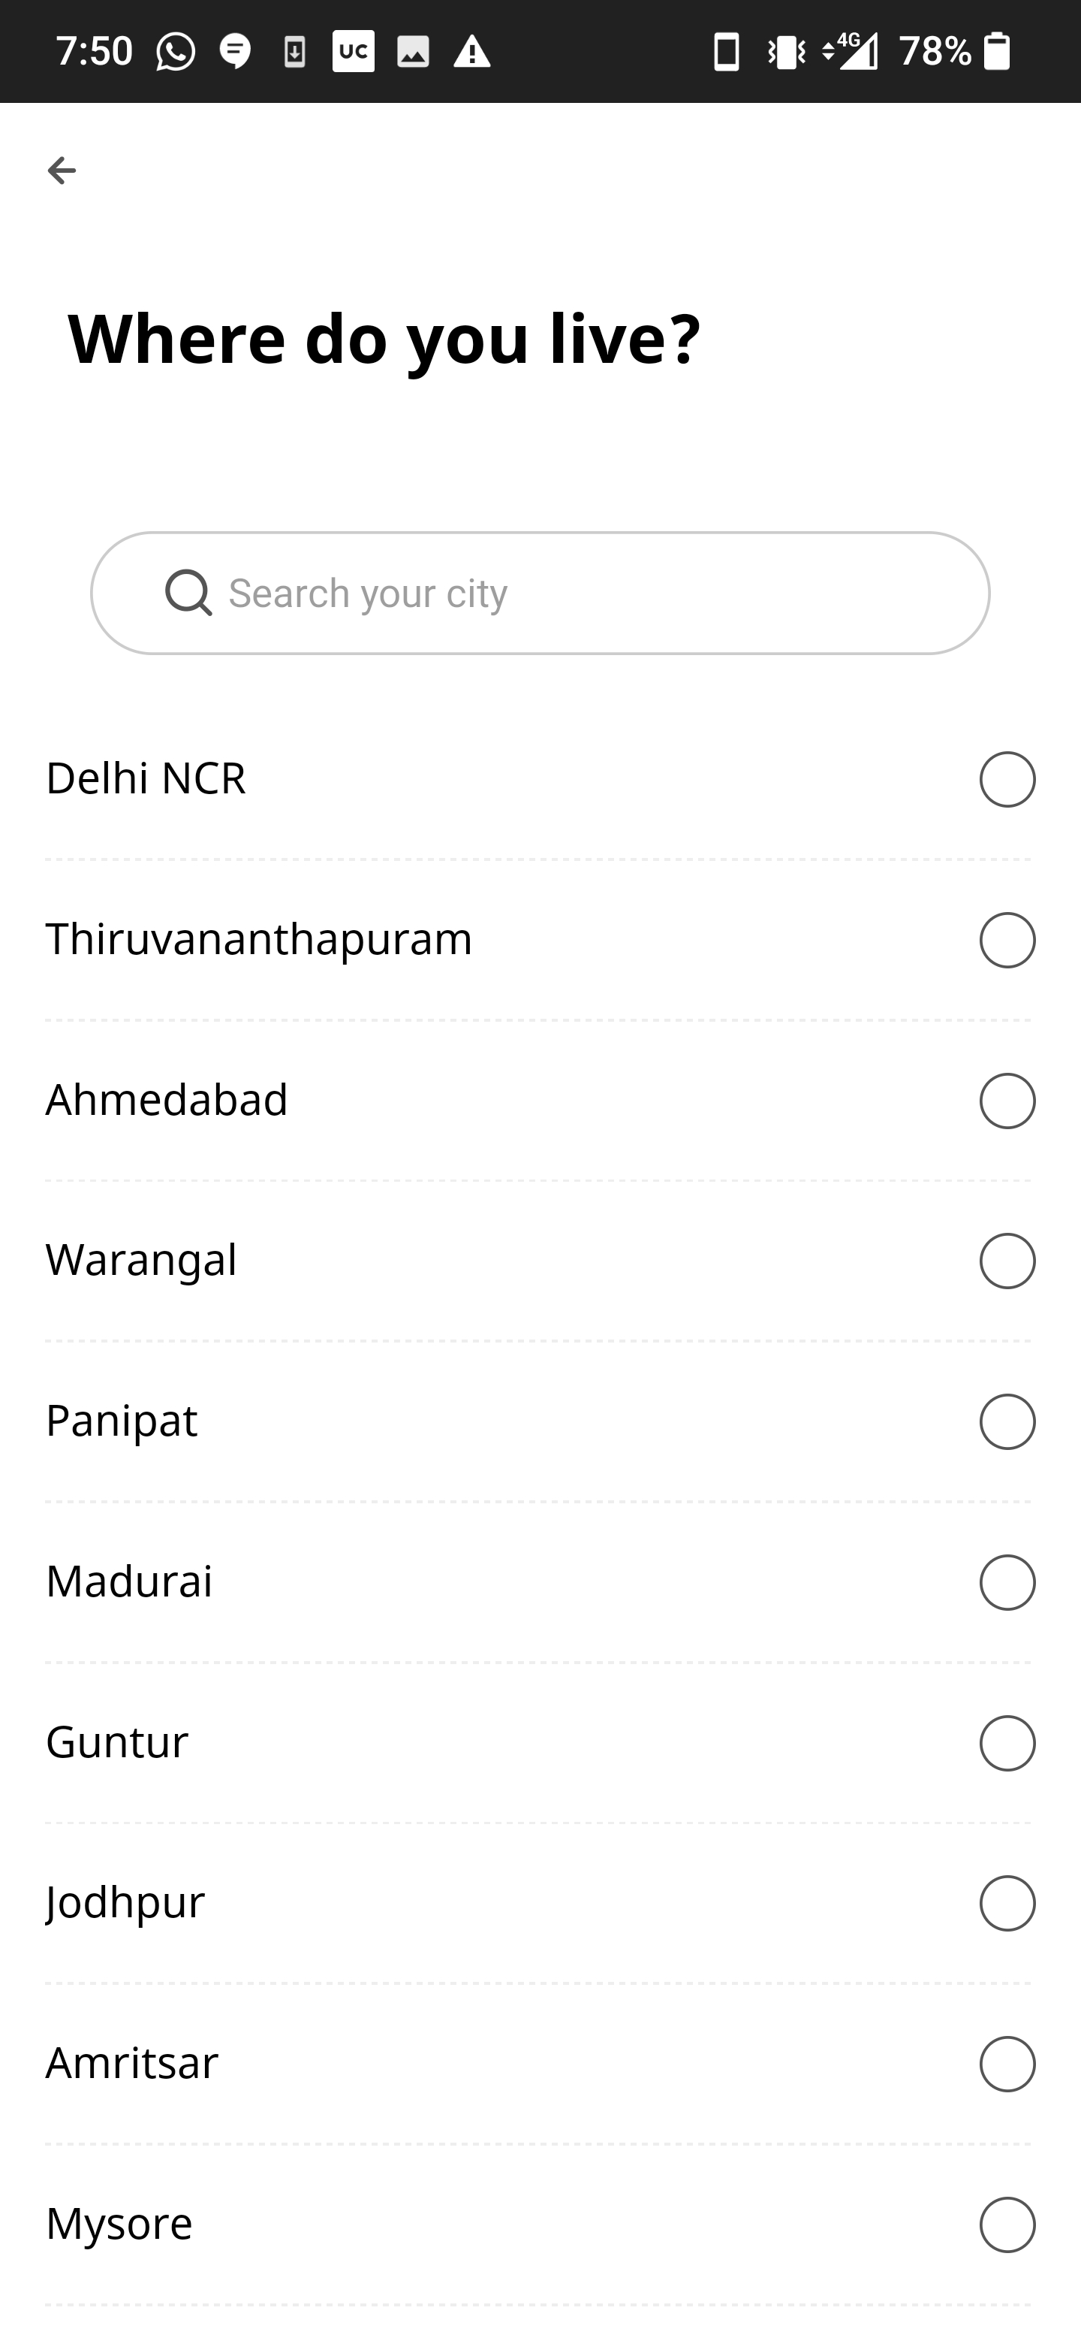
Add Area of Coverage
For the services selected, the SP must add its area of coverage
The given radius by the SP, will be used for geo fencing.
Area of coverage selection also depends on the package selected.

Slide 32
Services and Prices Review
Once the SP has submitted its selected services and respective prices, they will be sent for a review.
If the review is approved, the services of the SP will be listed live on the user app.
If not, the process will be repeated.

Slide 33
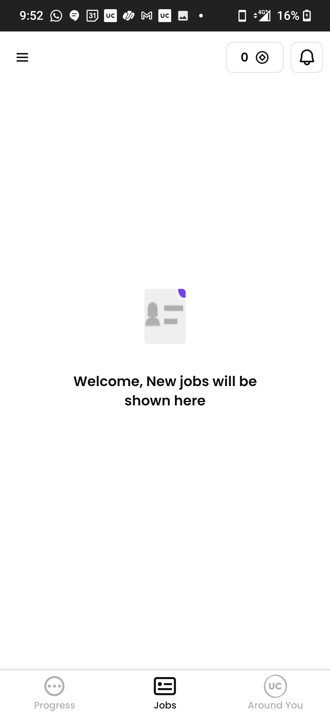
Accept/Reject Service Orders
If the user selects a SP and books the service, the service provider will be given live alerts that they have been booked for a service.
The SP can accept the booking and agree to serve.
The SP can also choose to reject the booking by mentioning the reason.
If the SP cancels a booking, the booking will go to the next SP and the cycle continues until SP accepts a booking.

Slide 34
Start session
When the SP accepts a service order, the details of user such as Type of service, service location, date and time will be given to the SP.
The SP can chat with the user using inbuilt - app messaging.
The SP/user cannot have the contact details directly, they will have to call via app extension.
Once the SP has reached the service location, he has to start the session and update the same on the app.

Slide 35
End session
After the service is completed, the SP will have to update on the app.
At this time, the SP will be asked if the service as completed in the booked time or was it extended.
If extended, the SP will have to mention by how many minutes was it extended.
The extra charges will be added accordingly.

Slide 36
Receive Payment
After the service is completed, and the payment is processed by the user.
The SP will receive their payment directly to their bank accounts after the deduction of booking fee, and service commission.
If the user has added any tips for the SP, they will receive that with no deductions.

Slide 37
Revenue Generation
1. Commission: A standard commission will be charged to the SP on successful service completion. 2. Booking Fee: A standard booking fee on each service booking will be charged to the user. 3a. User Subscriptions: Different packages will be designed and listed for the users from which, the user can purchase the desired package. 3b. SP Subscriptions: Different packages will be designed and listed for the SPs from which, the SP can purchase the desired package, which will unlock additional features such as extra number of services, discounted prices, large area of coverage etc. 4. In-App Advertisements: This will be done on a later stage, where we will allow our platform to display other advertisements and charge accordingly. 5. And many more…

Slide 38
Analysis Model
As of now, we will now have 3 modules:
Admin
2. User
3. Service Provider

Slide 39
Admin Module
The administrator is the one who manages the entire website/application.
The administrator possess all the information concerning the users and service providers.
This module is divided into different sub-modules, such as:
Manage Users
Manage Service Providers
Manage Bookings
Manage Payments
Etc.

Slide 40
Manage Users
i) View Users:
The admin can view of all the users registered in the system. Admin can view all the details of each user in the list.
ii) Approve user type:
Admin has the privileges to approve a user directly by providing the details for the type of service and plans selected by the users.
iii) Block Users:
Administrator has a right to block a user.
iv) Etc.

Slide 41
Manage Service Providers
View SPs: The admin can view of all the users registered in the system. Admin can view all the details of each user in the list.
Approve SPs: SPs forms, services, prices, and other details will be verified by the admin.
Block SPs: Admin can restrict a Service provider from managing the orders by blocking them. Admin can unblock a blocked Service provider if needed.
Delete SPs: Admin has the privilege to delete a Service Providers.
Search SPs: The admin should be able to search SP based on location, price, services, Etc.
Add/Remove Service Categories: An admin can Add/Remove the type/number of Services and manage a group of Services.

Slide 42
Manage Bookings:
i) View Orders: All existing orders can be viewed by the administrator. If there are a number of Service orders and an admin needs to find one of them, the admin can search for an order ID.
ii) Search Orders: Admin can also search for particular orders using order id, username, and categories.
iii) Edit Orders: The admin should be able to edit order details as per requirement and monitor the same.

Slide 43
Manage Payments:
Verify Payments
Divide Payments: Booking fee, Commission
Generate Invoices
Etc

Slide 44
Other Tasks
View locations of clients and local vendors
Record Management System for Partners and Clients
Keep Work Records, Billing, and Payment History
Accounts and Taxation
Set Ads and Promotions
Price and Subscription Plan Management
Etc

Slide 45
Service Provider Module
Here, the service provider refers to the individual/organization who is/are managing the services provided on the app.
This module is divided into different sub-modules:
1. Manage Services
2. Manage Orders
3. Manage Payments

Slide 46
Manage Services
Intensive Training: The service provider can be listed only after going through the intensive training module. If the training is successfully completed, then Service provider is enabled to permissions to add its services.
Select Services: The service provider can add and select services.
Accept/Reject Services: Once the user selects a service, the service providers of the particular area are notified. They can either accept or reject the offer. (Here, the user is also allowed to check and select the service provider and service personnel)

Slide 47
Manage Services
Manage Timeslot: The service provider needs to add its working timeslot
Add working areas: Add multiple working areas.
Notifications: If the service provider accepts the order, both the user and the service provider will receive a notification about the same.

Slide 48
Manage Orders
Accept Bookings: The service provider can accept a booking and complete it (start session & end session).
Cancel Bookings: The service provider can cancel a booking in case of an emergency, but they will have to mention the reason for it, their ratings will be affected upon each cancellation.
View all bookings: Display all bookings, find any particular booking among the lot. The service provider can search for a booking by name, id, categories, or status of booking.

Slide 49
Manage Payment Options
Payment Details: The service provider can enlist different types of payment modes.
Payment Report: The service provider can also generate payment reports such as: daily reports, monthly reports, or yearly reports.

Slide 50
Other Tasks
Fast & Simple Login /Registration Feature
Chat With A Customer
Add service charges based on hourly, fixed, and experienced base quotes.
Set Availability and Service Times
Reply to customer reviews/feedback.
Show Work History & Payment History
Keep GPS Location Tracking
Etc

Slide 51
User Module
Here, the user module refers to the end-user, who will utilize the services provided to meet their needs.
This module is divided into different sub-modules, such as:
1. Manage Profile:
Registration: A new user will have to register into the system by providing essential details in order to view the Services in the system.
Login: A user must login with a username and password to the system after registration. If a user is not registered, mobile number registration and otp verification can be used to login successfully.
Edit Profile: The user can view and edit their profiles.

Slide 52
User Module
2. Manage Bookings:
View Services: User can view the list of Services based on their location after successful login. A detailed description of a particular Services can be viewed by users.
Search Services: Users can search for a particular Services in the list by name.
Add to cart: The users can add the desired service into their cart by clicking add option on the services. They can view the bookings by navigating to the Booking section. All orders added by cart can be viewed in the cart. User can remove an item from the cart by clicking remove.

Slide 53
User Module
Show Packages: Once the users choose a particular service, a pop-up will be prompted which contains packages. Users can select the packages according to their needs.
Add timeslot: The user has to add a specific time-slot to the service provider and confirm time and date.
Confirm Booking: After confirming the services in the cart the user can submit the cart by providing a booking address. On successful order placement, the cart will be empty.
Show Booking Status: User can monitor the Booking status as it changes from pending-accepted/rescheduled-rejected.

Slide 54
User Module
Show Booking Details: Displays the selected service provider Details like photo, name and its professional details.
Add Rating: Users can also rate and post a review of the service and in-turn gain rewards.
History: In the history section of the app, the users will have a list of all their previous Bookings.

Slide 55
User Module
3. Manage Payments:
Add Card Details
Save Cards
Manage in-app Wallet
Manage app credit (refunds/promos)

Slide 56
This is a first draft
More features and functionalities will be added as we move forward.

